Slide 1
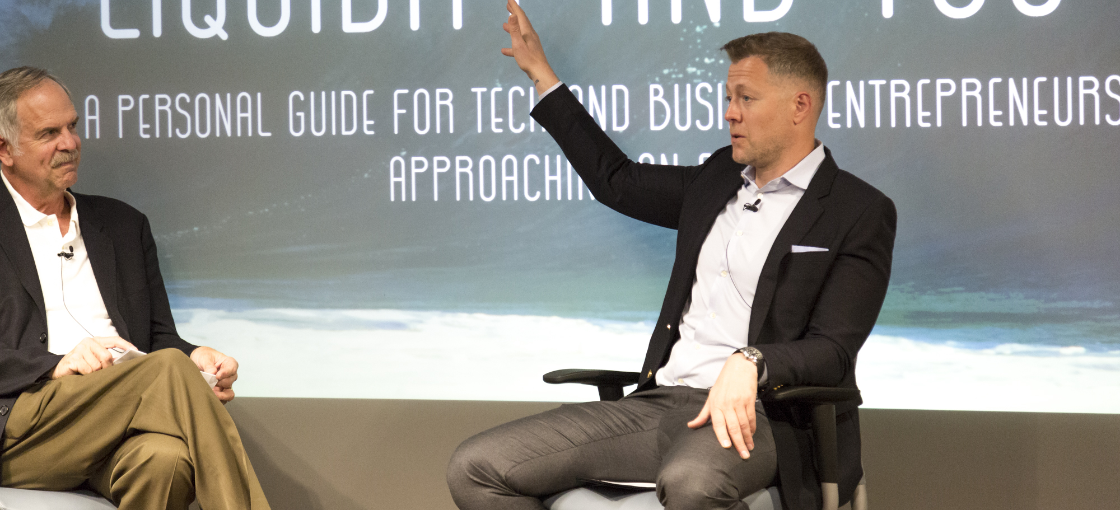
Anthony Glomski
Author of Liquidity & You: A Personal Guide for Entrepreneurs Approaching a Liquidity Event

Slide 2
LIQUIDITY & YOU
Entrepreneurs work hard to build their companies. As part of this journey, they create substantial wealth and value for themselves, their families, their employees, their shareholders, and their team members. Their drive to succeed propels them to heights most people only dream of reaching.
The reality is this is only part of the journey. Entrepreneurs want to make smart decisions so they can build their quality of life, take care of their loved ones, and change the world for the better. We are living in complicated and confusing times with increased uncertainty and a revamped tax code to navigate.

Slide 3
LIQUIDITY & YOU
With research showing over 87% of successful business owners are planning to sell their business someday, the need is greater than ever to find the right process for making smart decisions. Just a mere 12 % of former business owners say they were highly satisfied with the outcome after selling their companies.
Anthony Glomski of Liquidity and You provides a five-step process for business owners to make smart decisions about their money, minimize taxes, take care of their family, protect assets from being unjustly taken, and magnify their ability to help the causes they care about. Anthony’s presentations provide his audiences proven strategies they can execute with their professional advisors.

Slide 4
“Change is constant, challenges are inevitable, and the only way to survive is to create a solid support team around you and never give up. As you exit a business, change careers, or prepare for the next chapter in your life, curiosity and your attitude will be paramount to this transition or any other in your life… This book is a perfect place to start that journey.”
Brian Vickers, NASCAR Driver

Slide 5
SPEAKING TOPICS
Liquidity and You A Personal Guide for Tech and Business Entrepreneurs Approaching an Exit
1
2
Becoming Seriously Wealthy How to Harness the Strategies of the Super Rich
3
What To Do After You Write Your Book 5 Steps to Accelerate Your Growth
CONNECT WITH US: liquidityandyou.com/speaking

Slide 6
About
Anthony glomski
Anthony Glomski works with tech entrepreneurs and business owners approaching a liquidity event.
Anthony is the author of Liquidity and You: A Personal Guide for Tech and Business Entrepreneurs Approaching an Exit. His work with tech entrepreneurs and business owners helps them make smart decisions with their money and lives. Anthony believes in the importance of gaining a detailed understanding of his clients’ deepest values and goals to best guide their future.
Anthony’s 18 years of industry-specific work opened his eyes to the dilemma many entrepreneurs face. As business owners, they are responsible for looking out for employees and family, but oftentimes no one is looking out for them. This is the key issue that inspired his own venture to solve that problem.
He is an alumnus of KPMG, a member of the Milken Institute Associates & Young Leaders Circle, and is active in several charities including the Surfrider Foundation. An avid surfer and a racing enthusiast, Anthony is a member of the Silicon Beach Surfers and the Porsche Club of America. He splits his time between Los Angeles and New York. He has been featured in Forbes, US News & World Report, Yahoo! Tech, CIO, and NASDAQ, among others.
“Anthony sheds light on strategies that will help you prepare for the future instead of being forced to react to events that have already taken place.”
- Jim Carlin, Founder & Partner, Holthouse Carlin & Van Trigt LLP

Slide 7
Entrepreneurs can maximize their social impact on the causes they care about most, while also ensuring that they remain well-positioned to achieve their full range of financial goals.
- ANTHONY GLOMSKI

Slide 8
As seen in

Slide 9
WHAT PEOPLE ARE SAYING
“
Anthony Glomski’s Liquidity & You is a must read.
- Chirag Chotalia, Venture Capitalist, Draper Fisher Jurvetson; Former VC Pritzker Family Office
Liquidity & You identifies the right questions to ask yourself, other entrepreneurs, and future advisors.
- Paul Glomski, Co-founder and CEO, Detroit Labs
The punchline of Anthony’s book is…make up a great team to create the best long-term results.
- Brian Stevens, CEO, ConferenceDirect
I have a lot of respect for Anthony personally and professionally. Empty your bucket and start reading...
- Brian Vickers, NASCAR Driver
“
“
“

Slide 10
“If you’re looking for gold medal results, read Liquidity & You and follow Anthony’s advice.”
- John Naber, Olympic Champion, author, speaker and network sports announcer
@anthonyglomski
Liquidityandyou.com

